Slide 1

GoldVista Jewellers Retail Analytics
Business Intelligence & Data Analytics Project
Presented by: Ragina V
POSTGRESQL
EXCEL
POWER BI
DAX
GITHUB

Slide 2
Agenda
This presentation walks through the end-to-end analytics project — from understanding the business problem to delivering actionable insights and recommendations.
01
02
Business Overview
Problem Statement
About GoldVista Jewellers
Key business challenges
03
04
Project Objectives
Data Architecture
What we set out to achieve
Technology stack & pipeline
05
06
Data Cleaning & Transformation
Data Model
Preparing raw data for analysis
Star Schema design
07
08
SQL Business Analysis
Power BI Dashboards
Eight business challenges solved
Interactive visual reporting
09
10
Key Insights & Recommendations
Conclusion
Findings and next steps
Project summary

Slide 3


Business Overview
About GoldVista Jewellers
GoldVista Jewellers is a multi-branch jewellery retail business offering Gold, Diamond, Silver, and Platinum products. The business handles sales, returns, and old gold buy-back transactions, serving thousands of customers across multiple branches.
Product Range
Transaction Types
Gold, Diamond, Silver & Platinum jewellery across all branches
Sales, returns, and old gold buy-back activities managed centrally
Customer Base
Thousands of customers served across multiple retail branches
Purpose: Convert raw transactional data into actionable business insights.

Slide 4

Problem Statement
Business Challenges
GoldVista's operations were constrained by manual processes and a lack of centralized visibility, making it difficult to monitor performance across branches, products, customers, and staff.
Reporting & Visibility
Manual reporting processes with no centralized dashboard. Poor visibility into returns and buy-back activities across branches.
Performance Tracking
Difficulty comparing branch performance and monitoring individual salesperson effectiveness.
Analytics Gaps
Limited customer analytics and no product performance tracking to guide business decisions.

Slide 5
Project Objectives
The project aimed to build a comprehensive BI solution addressing every layer of GoldVista's operations — from executive KPIs to frontline salesperson performance.
Interactive BI Solution
Branch & Customer Analysis
Build an interactive BI solution to track executive KPIs and enable data-driven decision-making across the business.
Analyze branch performance and understand customer behavior to identify trends and opportunities.
Product & Returns Monitoring
Payment & Salesperson Insights
Evaluate product performance and monitor returns and buy-back trends to optimize inventory and operations.
Analyze payment method preferences and measure salesperson effectiveness across all branches.

Slide 6
Technology Stack
Each layer of the project leverages a purpose-built tool, forming a modern, end-to-end analytics pipeline from raw
data to interactive dashboards.
PostgreSQL
SQL
Database layer for storing and querying transactional data
Data cleaning and transformation using SQL views
SQL + DAX
Power BI
Business analysis and calculated measures
Interactive visualization and dashboard layer
GitHub
Excel
Version control for all project files and scripts
Documentation and supplementary data analysis

Slide 7
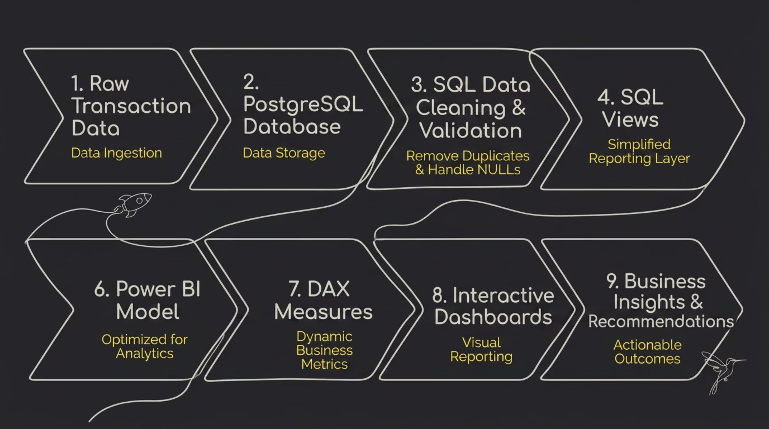
Project Architecture
The complete data flow moves from raw source data through a structured pipeline transaction data through to business insights and recommendations
Source data from GoldVista's branches flows into a PostgreSQL database, where SQL cleaning views standardize and prepare the data. A star schema organizes the cleaned data into fact and dimension tables, which Power BI consumes to build its data model with DAX measures. The result is a set of interactive dashboards that enable business decision-making across the organization.

Slide 8

Data Cleaning & Transformation
Before building the dashboards, the raw transactional data was cleaned and validated using SQL to ensure accuracy and consistency. This section covers the data preparation process, the DAX measures that powered the Power BI dashboards, the challenges encountered, and future enhancement opportunities.
DATA ENGINEERING
POWER BI
SQL

Slide 9
The Data Cleaning Process
Raw transactional data was cleaned and validated using SQL to ensure accuracy and consistency before any analysis was performed. The following steps were applied to prepare the dataset for reporting.
1
Remove Duplicates
Removed duplicate records to prevent duplicate sales calculations.
2
Handle NULL Values
Handled missing (NULL) values to improve data completeness.
3
Standardize Dates
Standardized date formats to enable accurate time-based analysis.
4
Correct Inconsistencies
Corrected inconsistent data to maintain quality across tables.
5
Flag Returns
Flagged return transactions to separate sales from returns.
6
Create SQL Views
Created SQL views to simplify reporting and Power BI integration.
7
Validate Relationships
Validated relationships to ensure referential integrity between tables.

Slide 10
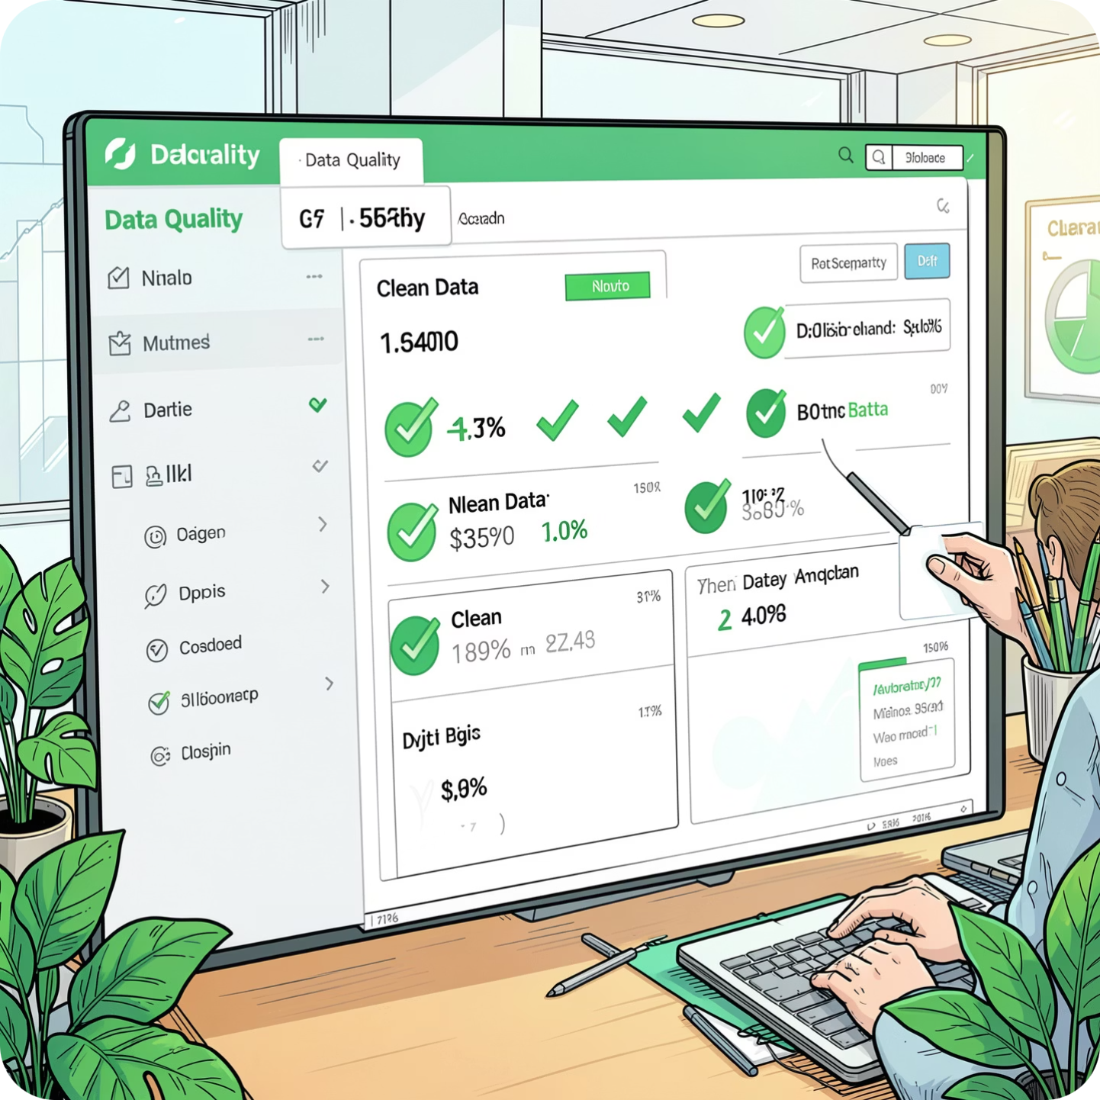
Key Outcomes of Data Cleaning
What Was Achieved
Improved data accuracy and reliability across all tables
Created a clean, validated dataset ready for reporting
Enhanced dashboard performance and consistency
These steps ensured that the dashboards were built on accurate and reliable data, enabling management to analyze business performance interactively using filters and slicers.

Slide 11
SQL Business Analysis
Eight business challenges were solved using advanced SQL techniques — including GROUP BY, JOINs, Window Functions, CASE statements, CTEs, and Aggregate Functions.
Executive Analysis
Branch Analysis
Company-wide KPIs
Compare branch performance
Product Analysis
Customer Analysis
Best-selling products
Customer behavior patterns
Returns Analysis
Buy-back Analysis
Return trends and rates
Old gold activity tracking
Payment Analysis
Salesperson Analysis
Payment method preferences
Employee performance metrics

Slide 12
CHALLENGE 1
Executive Sales Performance
Objective: Provide management with a high-level overview of company performance through key sales
KPIs and revenue trends.
Key Insights
Recommendations
Total revenue shows a consistent growth trend over the reporting period.
Revenue is primarily driven by Gold jewellery compared to other divisions.
22K products contribute the largest share of total sales.
A small number of branches generate a significant portion of company revenue.
Monthly sales fluctuate during festive and promotional periods, indicating seasonal demand.
Increase inventory levels for high-demand 22K products.
Plan marketing campaigns around seasonal sales peaks.
Benchmark top-performing branches and replicate strategies across locations.
Monitor executive KPIs regularly to enable proactive decision-making.

Slide 13

CHALLENGE 2
Branch Performance Analysis
Objective: Evaluate branch-level performance and identify opportunities for operational improvement.
Key Insights
Revenue performance varies significantly across branches.
Some branches achieve high revenue with fewer transactions, indicating higher average transaction values.
Branch-specific karat preferences differ based on customer demographics.
Salesperson productivity varies considerably within branches.
Payment preferences differ across locations.
Recommendations
Share best practices from high-performing branches with lower-performing locations.
Conduct branch-level performance reviews using KPI scorecards.
Optimize branch inventory according to local customer preferences.
Introduce branch-specific sales improvement initiatives.

Slide 14
CHALLENGE 3
Sales & Product Performance
Objective: Identify high-performing products and evaluate product profitability.
Key Insights
Recommendations
Rings and Chains contribute a major share of total revenue.
Certain Item Type × Karat combinations consistently outperform others.
Products with higher making charges generate better profit margins.
Discount patterns differ across product categories.
A small number of products contribute disproportionately to overall sales.
Prioritize inventory replenishment for top-selling products.
Focus promotional campaigns on high-margin product categories.
Review low-performing products for redesign or discontinuation.
Strengthen discount approval policies to protect profitability.

Slide 15


CHALLENGE 4
Customer Intelligence
Objective: Understand customer behavior, loyalty, and long-term business value.
Key Insights
Recommendations
A large percentage of customers make only one purchase.
Returning customers generate a substantial share of revenue.
VIP customers contribute significantly more revenue than other segments.
Customer lifetime value varies across segments.
Purchase frequency highlights opportunities for retention improvement.
Launch customer loyalty and rewards programs.
Develop personalized marketing campaigns based on customer segments.
Offer exclusive benefits to VIP customers.
Implement targeted campaigns to convert one-time buyers into repeat customers.
Track customer retention using cohort analysis.

Slide 16

CHALLENGE 5
Returns & Buy-Back Analysis
Objective: Analyze return patterns and evaluate old gold buy-back activities.
Key Insights
Overall return rates remain relatively low, indicating good product quality.
Certain branches record higher return percentages than others.
Some item types experience more frequent returns.
Old gold buy-back programs contribute significantly to business activity.
Customers using buy-back programs often purchase higher-value products.
Recommendations
Investigate branches with unusually high return rates.
Improve quality control for frequently returned products.
Expand old gold exchange campaigns to drive additional sales.
Use return trend monitoring to identify operational issues early.
Encourage customers to upgrade jewellery through buy-back offers.

Slide 17
CHALLENGE 6
Payment & Salesperson Performance
Objective: Evaluate payment behavior and salesperson effectiveness.
Recommendations
Key Insights
Encourage digital payments through customer incentives.
Recognize and reward top-performing salespeople.
Provide coaching for employees with lower performance metrics.
Implement approval workflows for excessive discounts.
Use dashboard insights during monthly performance reviews.
Cash remains the dominant payment mode, although digital payments continue to increase.
Payment preferences vary by branch.
A small group of salespeople generates a significant proportion of revenue.
Some salespeople consistently offer higher discounts.
Balanced evaluation requires considering revenue, transaction count, and return rate together.

Slide 18
CHALLENGE 7
Customer Retention & Loyalty
Objective: Measure customer retention and improve long-term customer relationships.
Key Insights
Recommendations
Repeat purchase rates indicate opportunities to improve customer loyalty.
Returning customers contribute stable long-term revenue.
Cohort analysis reveals varying retention rates across customer groups.
Customer acquisition alone is insufficient for sustainable growth.
Introduce membership and loyalty programs.
Send personalized offers based on purchase history.
Re-engage inactive customers through targeted campaigns.
Monitor retention KPIs alongside acquisition metrics.
Focus on increasing customer lifetime value rather than only acquiring new customers.

Slide 19
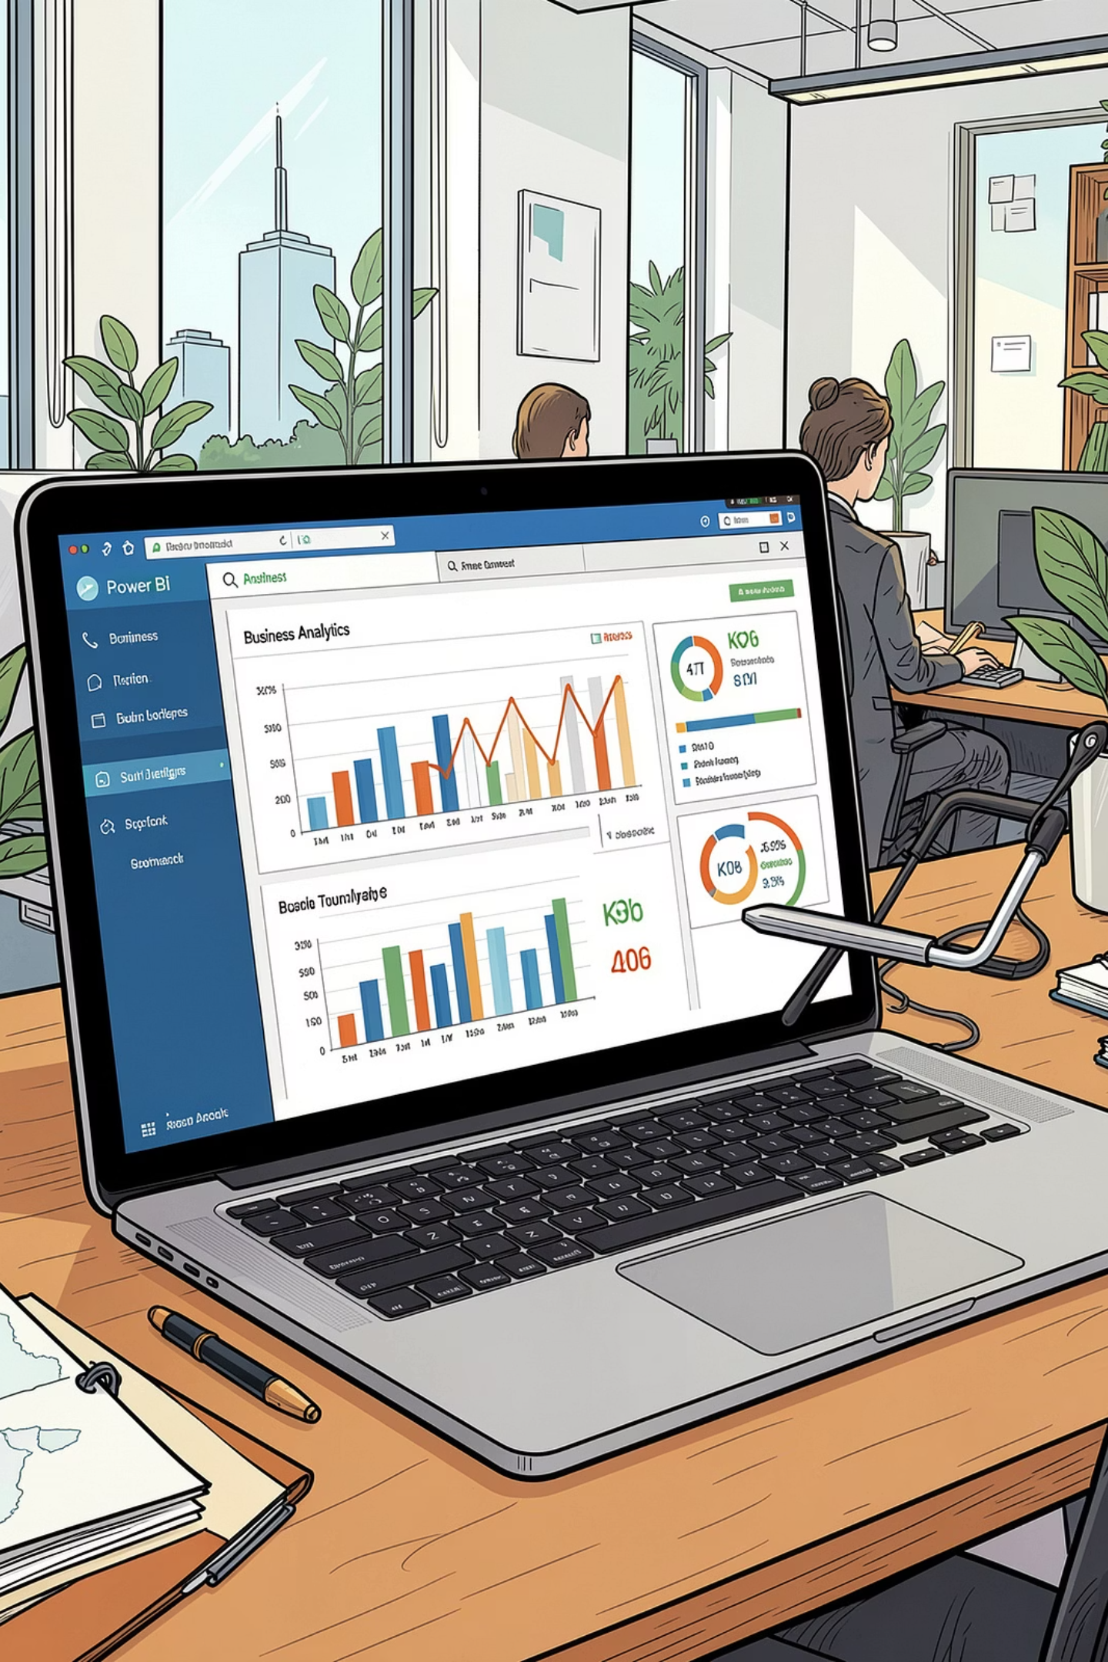
CHALLENGE 8
Executive Business Intelligence & Decision Support
Objective: Deliver a centralized reporting solution that enables data-driven decision-making.
1
Key Insights
Interactive dashboards reduce dependency on manual reporting.
Cross-filtering and drill-through capabilities enable deeper analysis.
KPI monitoring supports faster identification of business trends.
Combining financial, operational, and customer data provides a comprehensive business view.
Self-service analytics empowers managers to answer business questions independently.
2
Recommendations
Adopt Power BI dashboards as part of regular management review meetings.
Standardize KPI definitions across departments.
Schedule automated dashboard refreshes for real-time monitoring.
Expand analytics capabilities with predictive forecasting and machine learning.
Promote a data-driven culture by integrating dashboard insights into strategic planning.

Slide 20
Key DAX Measures
Power BI dashboards were powered by several DAX measures, including Total Revenue, Average Invoice Value, Return Percentage, Customer Lifetime Value, and Month-over-Month Growth. These dynamic calculations allow management to analyze business performance interactively using filters and slicers across branches, products, customers, and time periods.
Total Revenue
Invoice Count
Total sales excluding returns
Number of sales invoices
Customer Count
Average Invoice Value
Number of unique customers
Average revenue per invoice
Return Count
Return %
Total return transactions
Return rate based on invoice count

Slide 21
Advanced DAX Measures
In addition to core revenue and transaction metrics, advanced DAX measures were created to support deeper customer analysis and financial performance tracking.
Making Revenue
Discount Amount & %
Total making charges collected
Total discounts provided and percentage of discount against revenue
New & Repeat Customers
Customer Lifetime Value (CLV)
Customers with first purchase vs. customers with multiple purchases
Average revenue generated per customer
Purchase Count
Month-over-Month Growth
Number of purchases by each customer
Monthly revenue growth percentage

Slide 22
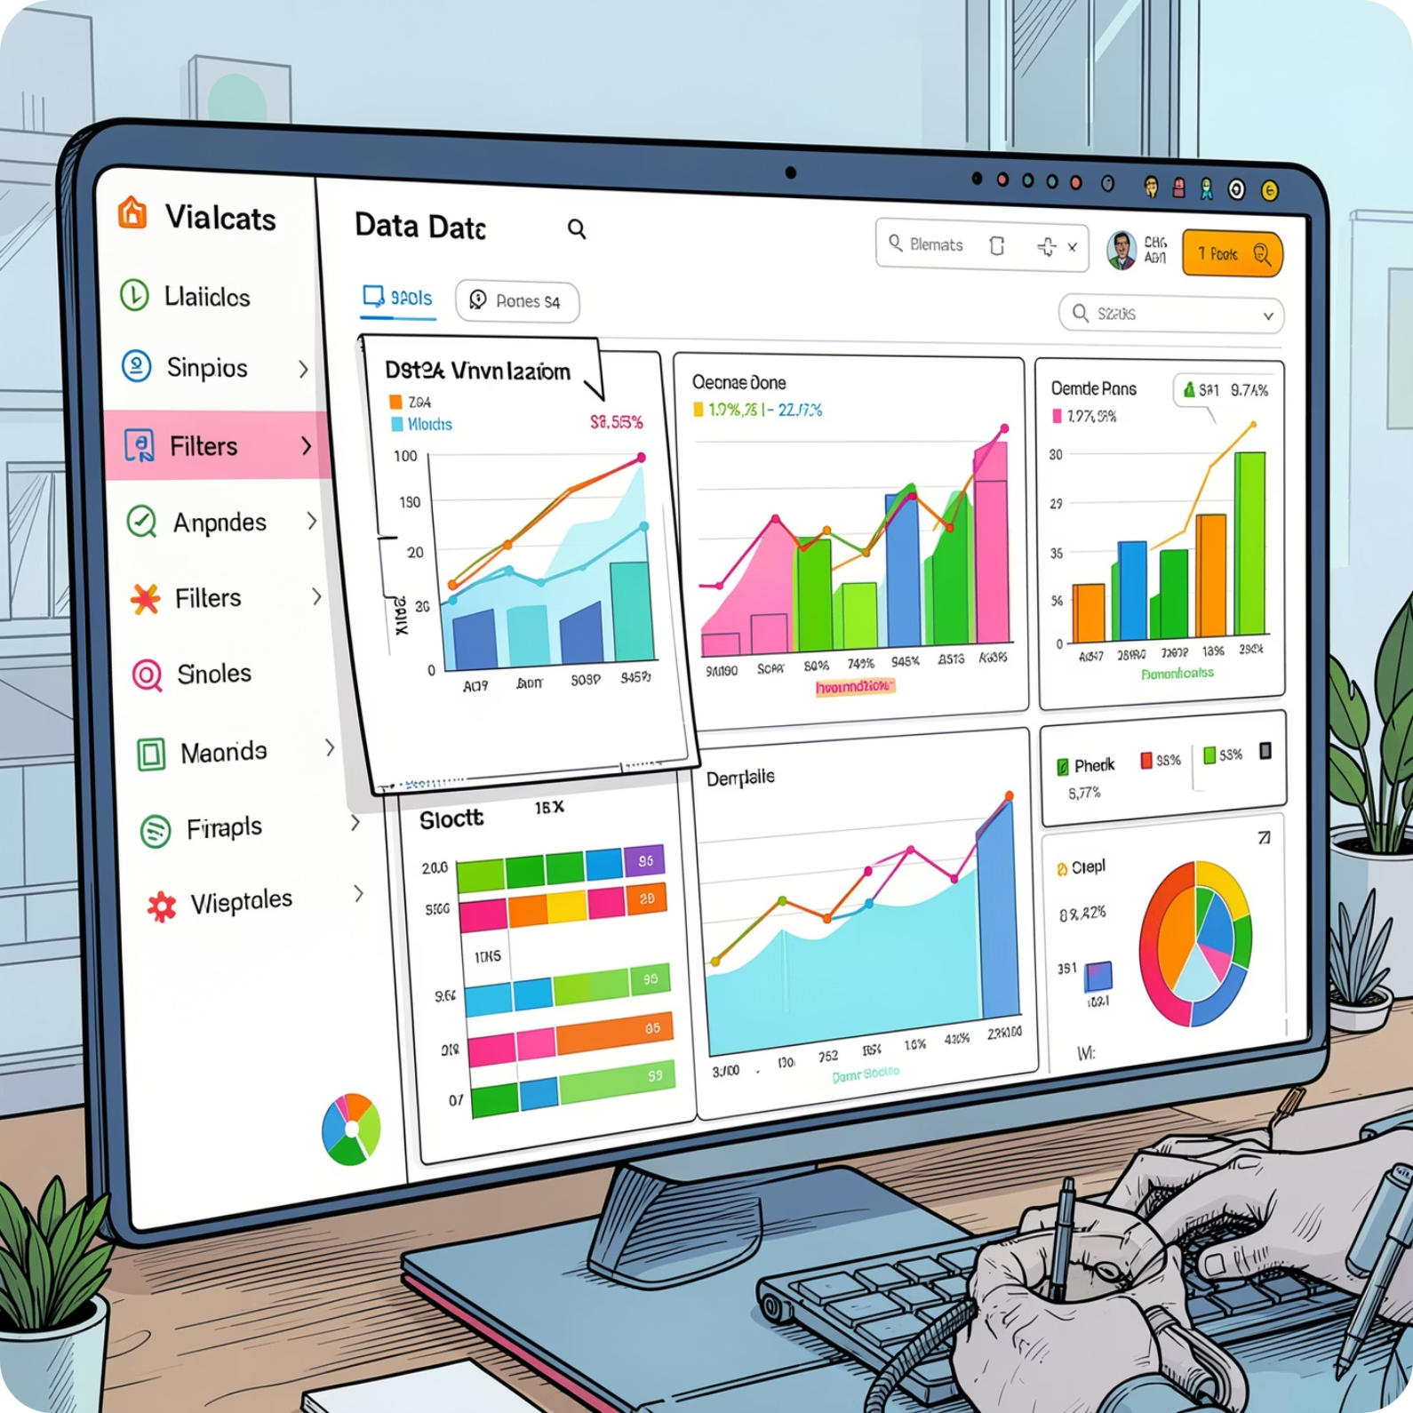

Why DAX?
Dynamic Calculations
DAX measures provide dynamic calculations that automatically update based on filters and slicers, enabling interactive analysis across branches, products, customers, and time periods.
These dynamic calculations allow management to analyze business performance interactively, supporting data-driven decision-making at every level of the organization.
DAX measures power all 6 interactive dashboards, updating automatically as users apply filters and slicers.

Slide 23
Data Model — Star Schema
Schema Structure
Why Star Schema?
The star schema centers on a Fact Sales table connected to dimension tables: Dim Branch, Dim Product, Dim Customer, and Dim Date. All relationships use one-to-many joins from dimension to fact tables.
A star schema improves reporting performance by simplifying queries and reducing join complexity. With denormalized dimension tables and a single fact table at the center, Power BI can aggregate large volumes of transactional data efficiently — enabling fast, responsive dashboards for executive and operational reporting.
Fact Tables
Dimension Tables
Store transactional records — sales, returns, and buy-backs
Branch, Product, Customer, and Date attributes
One-to-Many Joins
Dimensions connect to facts via foreign keys

Slide 24
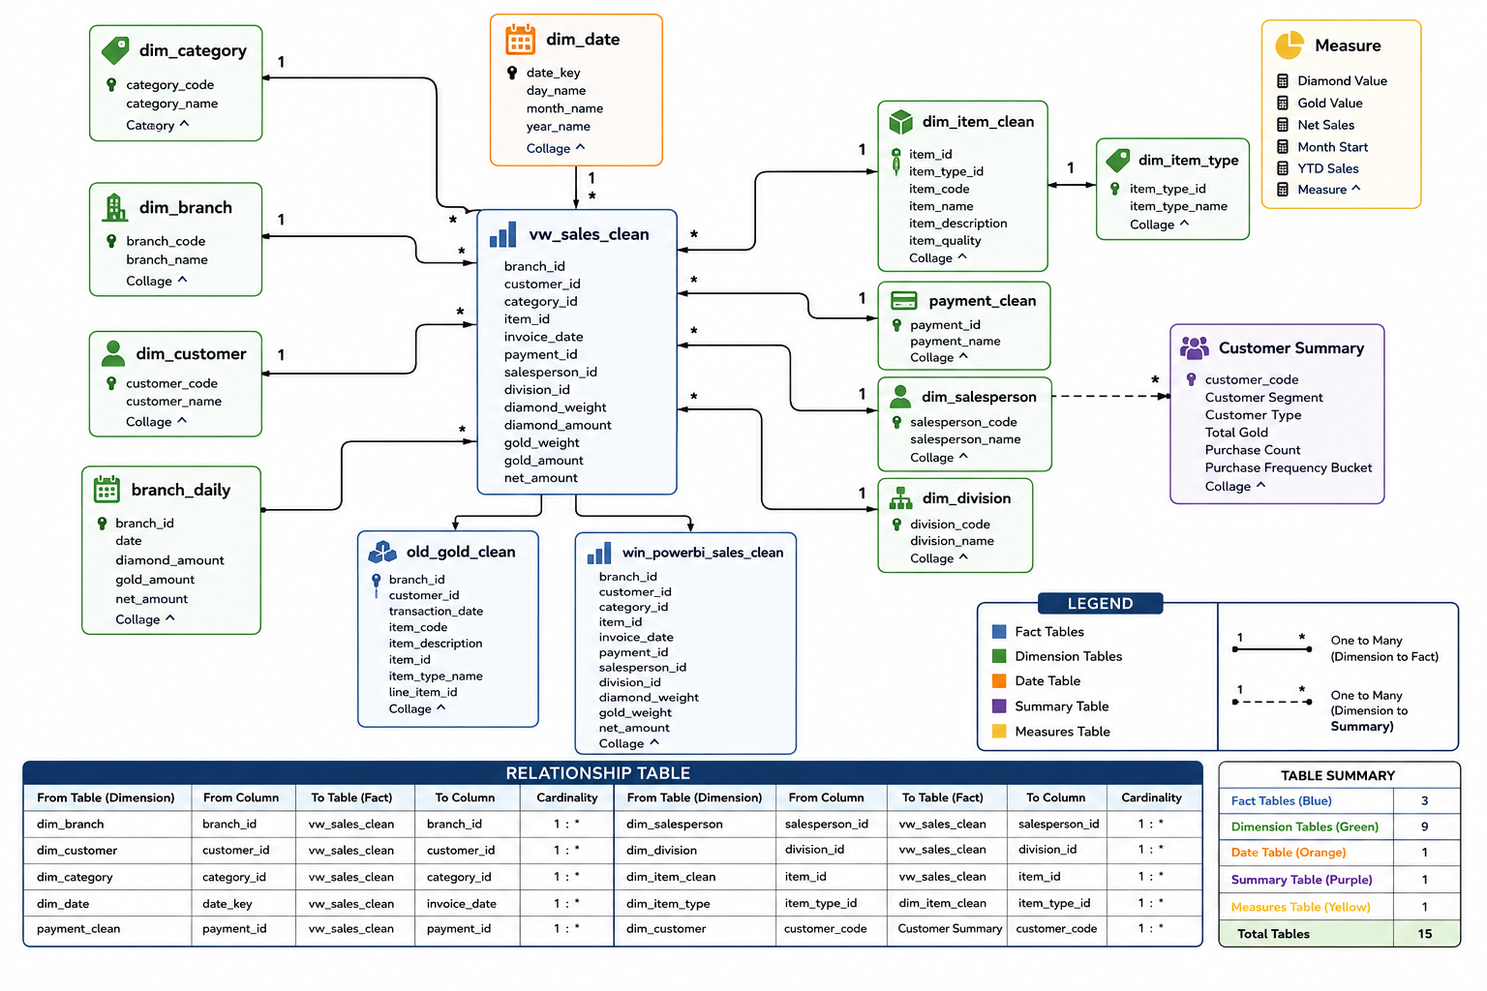
Data Model — Star Schema

Slide 25

Business Intelligence Dashboard Suite
An end-to-end BI solution built with PostgreSQL and Power BI — transforming raw transactional data into strategic insights across sales, customers, branches, products, payments, and returns.
6 INTERACTIVE DASHBOARDS
8 BUSINESS CHALLENGES SOLVED

Slide 26

Executive Dashboard
Provides an overall business performance overview at a glance, consolidating the most critical KPIs into a single view for leadership decision-making.
Total Revenue
Invoice Count
Overall business revenue tracked across all branches and product categories
Total number of invoices processed, reflecting
transaction volume
Active Customers
Avg Invoice Value
Number of active customers engaging with the
business
Average value per invoice, indicating transaction size and customer spend
Return Rate
Making Revenue
Rate of product returns across the business
Revenue from making charges, a significant contributor
to profit
Key Insights: 22K products generate the highest revenue. Revenue is concentrated in a few branches. Return rate is low. Making charges contribute significantly to profit.

Slide 27
Branch Performance Dashboard
This dashboard enables comparison of branch revenue, branch ranking, average transaction value, return rate, and salesperson contribution — providing a comprehensive view of how each branch performs relative to others.
Key Insights
Branch 16 has the highest revenue
Branch 18 has the highest average transaction value
Performance varies significantly between branches
What It Tracks
Branch revenue comparison and ranking
Average transaction value per branch
Return rate by branch
Salesperson contribution per branch
Significant performance differences exist among branches, highlighting opportunities to benchmark top-performing branches and replicate their practices across the network.

Slide 28
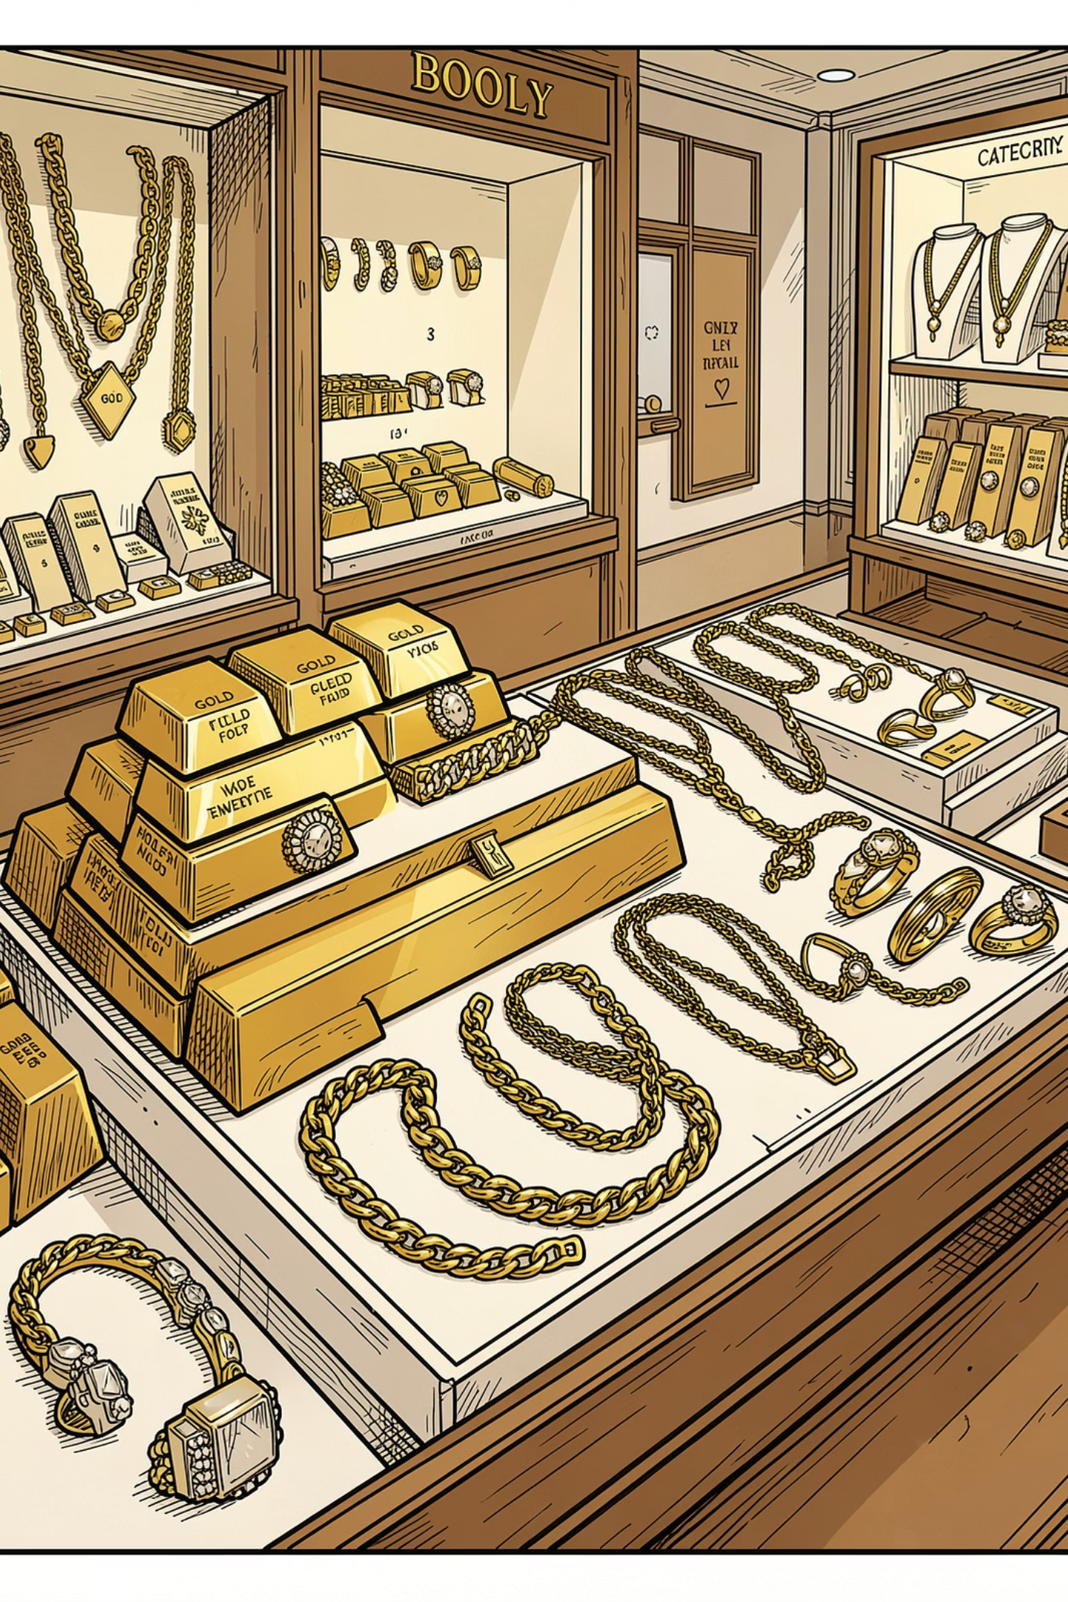
Sales & Product Dashboard
This dashboard analyses revenue by category, revenue by item type, karat analysis, making charges, and discount analysis — providing a detailed view of product performance across the business.
Revenue by Category & Item Type
Gold Bars and Chains are the top-performing products, generating the highest revenue across all categories. Some products contribute high revenue despite lower sales volume.
Karat Analysis
22K jewellery dominates sales, contributing the highest revenue. This karat segment should be prioritised in stock planning and inventory management.
Making Charges & Discount Analysis
Making charges contribute significantly to profit. Discount analysis reveals opportunities to optimise pricing policies across product categories.

Slide 29


Customer Intelligence Dashboard
This dashboard provides deep insights into customer behaviour through customer segmentation, repeat customer analysis, Customer Lifetime Value, purchase frequency, and cohort analysis — enabling targeted retention strategies.
84%
16%
One-Time Customers
Repeat Customers
The vast majority of the customer base are one-time buyers, representing a significant retention opportunity
Repeat customers generate much higher revenue per person compared to one-time buyers
Loyalty initiatives could significantly improve retention and increase overall revenue. Customer Lifetime Value and purchase frequency analysis further highlight the potential value of converting one-time buyers into repeat customers through targeted engagement programmes.

Slide 30

Returns & Buy-Back Dashboard
Tracks return trends, returns by branch, returns by product, and old gold buy-back analysis — providing a comprehensive view of product returns and buy-back activity across the business.
Return Rate
Return rate is around 1.7% — relatively low overall, though some branches have higher return rates that warrant investigation
Return by Branch & Product
Return trends vary by branch and product type, enabling identification of areas requiring attention or process improvement
Old Gold Buy-Back
Buy-back transactions contribute significantly to business volume. Expanding old gold buy-back campaigns can drive additional business and customer engagement

Slide 31
Payment & Salesperson Dashboard
This dashboard analyses payment mode distribution, salesperson ranking, discount analysis, and branch payment trends — offering insights into how customers pay and which salespersons drive the most value.
Salesperson Performance
Payment Mode Distribution
Top-performing salespersons consistently outperform their peers, highlighting significant performance differences. KPI-based salesperson incentives could help raise overall performance across the team.
Cash is the most preferred payment method across all branches. However, payment preferences differ across branches, suggesting opportunities to encourage digital payment adoption in specific locations.

Slide 32
Key Business Insights
1
22K Jewellery Dominates
22K jewellery contributes the highest revenue across all product categories
2
Branch Concentration
Revenue is concentrated in a few branches; significant performance differences exist across the network
3
Top Products
Gold Bars and Chains are the top-selling products by revenue
4
Customer Base
One-time customers form the majority of the customer base — a key retention opportunity
5
Cash Dominance
Cash remains the dominant payment method, though digital adoption is an opportunity
6
Buy-Back & Salesperson Impact
Buy-back programmes drive additional business volume, and significant performance differences exist among salespersons

Slide 33
Business Recommendations
Based on the dashboard insights, the following strategic actions are recommended to drive growth, improve
retention, and optimize operations.
Customer Loyalty
Stock Optimisation
Buy-Back Campaigns
Increase stock for high-performing products, particularly 22K jewellery and Gold Bars & Chains
Introduce customer loyalty programmes to convert one-time buyers into repeat customers
Expand old gold buy-back campaigns to drive additional business volume
Digital Payments
Branch Benchmarking
Discount & Incentives
Encourage digital payment adoption to reduce cash dependency across branches
Benchmark top-performing branches to replicate best practices across the network
Optimise discount policies and implement KPI-based salesperson incentives
Predictive Analytics
Use predictive analytics for demand forecasting to improve inventory and sales planning

Slide 34

Challenges Faced
During the project, the main challenges involved preparing high-quality data and designing an efficient analytical model.
Data Preparation
Cleaning and validating large transactional datasets, and handling duplicate and inconsistent records.
Data Modeling
Designing an optimized Star Schema data model and managing relationships between fact and dimension tables.
Reporting Design
Creating efficient DAX measures for dynamic reporting and building dashboards that balance detail with usability.

Slide 35
Future Enhancements
In future, this solution can be enhanced with predictive analytics, customer churn models, demand forecasting, and real-time reporting to provide even greater business value.
Predictive Analytics
Demand Forecasting
Implement machine learning for sales forecasting and predict customer churn and buying behavior.
Develop demand forecasting for inventory optimization.
Real-Time Reporting
AI Recommendations
Enable real-time dashboard refresh for up-to-the-minute business insights.
Add AI-driven product recommendations and create mobile-optimized executive dashboards.

Slide 36

Summary
This project delivered a complete end-to-end analytics solution — from raw transactional data through SQL cleaning and validation, Star Schema modeling, and DAX-powered Power BI dashboards — providing management with interactive tools to analyze business performance across branches, products, customers, and time periods.
Data Quality
Dynamic Metrics
SQL cleaning and validation ensured accurate, reliable data for reporting.
DAX measures enabled interactive analysis with filters and slicers across all dashboards.
6
Interactive Dashboards
Future Ready
Developed to support strategic decision-making across the business
Predictive analytics, real-time reporting, and AI-driven recommendations planned for future phases.
8
Business Challenges Solved
Key challenges addressed through SQL analysis and
Power BI visualisation

